Slide 1
Lecture 5 – Analysis Framework
CST370 – Design & Analysis of Algorithms
Dr. Byun
Computer Science

Slide 2
Lecture Objectives
After completion of this lecture, you will be able to
  explain the concept of “orders of growth" and “categories of time complexities” for algorithm analysis.
  distinguish the difference between a general “operation” and a “basic operation” in the algorithm description.
  understand the difference between “best case analysis” and “worst case analysis”.

Slide 3
Chapter 2: Fundamentals of the Analysis of Algorithm Efficiency
2.1 The Analysis Framework
2.2 Asymptotic Notations and Basic Efficiency Classes
2.3 Mathematical Analysis of Nonrecursive Algorithms
2.4 Mathematical Analysis of Recursive Algorithms

Slide 4
Introduction to Algorithm Analysis
Watch this video to get the basic idea of algorithm analysis.
  https://youtu.be/CR34s-PIT4k
Algorithm analysis is to determine the efficiency of an algorithm.
  It measures the amount of resources, typically time and memory, necessary to execute the algorithm.
Our main focus is time efficiency.
  It’s also called time complexity.

Slide 5
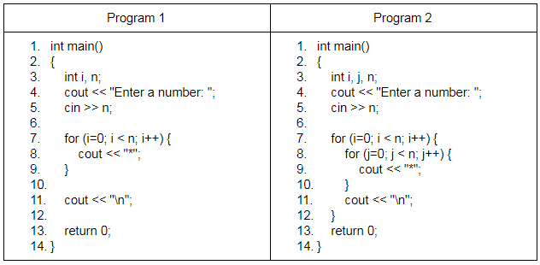
Two Sample Programs in C++
Which one looks fast and how much?
  Assume that n is a very big number.

Slide 6
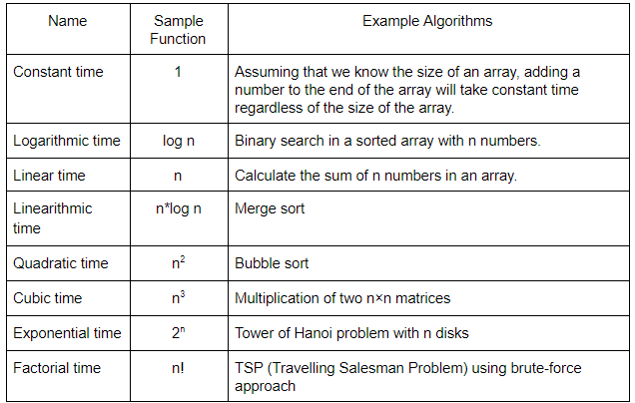
Eight Common Time Complexities

Slide 7
<<< Course Instruction >>>
Read the document named “Introduction to Algorithm Analysis” at
  https://goo.gl/VKeErt
In the document, you will learn three topics.
  Basic idea of algorithm analysis
  Concept of operations and basic operation
  Best case and worst case

Slide 8
Algorithm Analysis – Basic Idea
We count the number of basic operation executed while an algorithm runs.
  But since it’s not trivial to get the accurate number, we try to get an approximated one.

Slide 9
Example: Calculate the sum of an array
Algorithm SequentialAdd (A[0..n-1])
// Input: An array A with n numbers
// from the index 0 to n-1
// Output: Sum of the numbers in the array A
sum ← 0
i ← 0
while ( i < n ) do
sum ← sum + A[i]
i ← i + 1
return sum

Slide 10
Example: Identifying the basic operation
Algorithm SequentialAdd (A[0..n-1])
sum ← 0
i ← 0
while ( i < n ) do
sum ← sum + A[i]
i ← i + 1
return sum

Slide 11
Summary of Basic Operation
“Operation” means every operation in the pseudocode such as +, -, *, /,%, >, <, etc.
  In the class, we exclude the assignment operation.
“Basic operation” is the most frequently performed operation among all operations in a pseudocode (= algorithm).
Small difference between the numbers of operations executed is not important.

Slide 12
Analysis Framework
Algorithm efficiency analysis is to identify the order of growth of the counter of basic operation executed for large-size inputs.

Slide 13
Common Time Complexities: Again

Slide 14
Exercise
Present the eight most popular time complexity categories in the algorithm analysis.
If your program takes n² and your classmate’s program takes n*log n, whose program is faster?

Slide 15
Exercise
How many basic operation(s) in an algorithm (or pseudocode)?

Slide 16
Exercise: Identify Basic Operation
Algorithm FindMax (A[0..n-1])
// Input: An array A from the index 0 to n-1
// Output: Determine the max number of A
maxvalue ← A[0]
i ← 1
while ( i < n ) do
if (A[i] > maxvalue)
maxvalue ← A[i]
i ← i + 1
return maxvalue

Slide 17
Exercise: Identify Basic Operation
Algorithm Display_2D_Stars (n)
// Input: A positive integer number n
// Output: Display the * symbol in two dimensions.
i ← 0
while ( i < n ) do
j ← 0
while ( j < n ) do
write '*'
j ← j + 1
write '\n'
i ← i + 1
return 0

Slide 18
Worst-Case, Best-Case, and Average-Case Efficiencies
Some algorithms can have different execution times depending on the characteristics of the particular input.
  Thus, when we analyze those algorithms, we should consider the best-case, average-case, and worst-case time complexities separately.

Slide 19
Example – Sequential Search (1 of 3)
Algorithm SequentialSearch(A[0..n − 1], K)
// Input: An array A[0..n − 1] and a search key K
// Output: The index of the first element in A that
// matches K or −1 for no matching elements
i ←0
while ((i < n) AND (A[i] != K)) do
i ←i + 1
if i < n
return i
else
return −1

Slide 20
Example – Sequential Search (2 of 3)
Worst case
  A[ ] = [100, 5, 89, 70, 20, 64, 77]
  K: 55 (or 77)
Best case
  A[ ] = [100, 5, 89, 70, 20, 64, 77]
  K: 100

Slide 21
Example – Sequential Search (3 of 3)
Average case
  Time efficiency for “typical” or “random” inputs.
  Average-case efficiency can not be obtained by taking the average of the worst-case and the best-case efficiencies.
  It’s very difficult to obtain.
Our main interest will be the worst case.
  But sometimes we will talk about the best case and average case.

Slide 22
Exercise
Assume that your program finds the max value in an array.
  Would the efficiency be different depending on input form?

Slide 23
Puzzle: Choosing Balls in the Dark
Suppose you have three jars, A, B, and C, in a room.
  Jar A has five large black balls, four large red balls, and two large green balls.
  Jar B has five small black balls, four small red balls, and two small green balls.
  Jar C is empty.
  Now you will pick some balls from the jars A and B in the dark and place them in the jar C. In other words, the color of the selected balls can’t be confirmed because the surroundings are dark. However, by touching with the hand, the size of the balls can be known by feeling.
  Once you're done, you can turn on the lights in the room and see the balls in the jar C.

Slide 24
Best Case Analysis
Assuming the best case occurs, what is the minimum number of balls you have to choose to get a matching pair?
  Here, a matching pair means that there must be one large ball and one small ball of the same color in the jar C. But the color itself of the pair is not important.
Hint: The answer is very obvious. Typically, best case analysis is simple and straightforward.

Slide 25
Solution

Slide 26
Worst Case Analysis
Let's go back to the beginning of this puzzle.
Assuming the worst case occurs, what is the minimum number of balls you have to choose to get a matching pair?
  Again, the color of the pair itself is not important. However, one matching pair must be guaranteed.
This is a very challenging puzzle. Consider the worst case situation very carefully.

Slide 27
Solution

